Slide 1
This slide deck is not a presentation. It’s to export diagrams and images in an image format for use in markdown files.

Slide 2
Instructions
Create the graphic on a blank slide
Select the slide
Click File -> Export
Name the file, select the directory to export it to
lesson_number order_brief description.png
Change the file format to PNG
Set the dimensions to 1800 x 1013

Slide 3




Slide 4
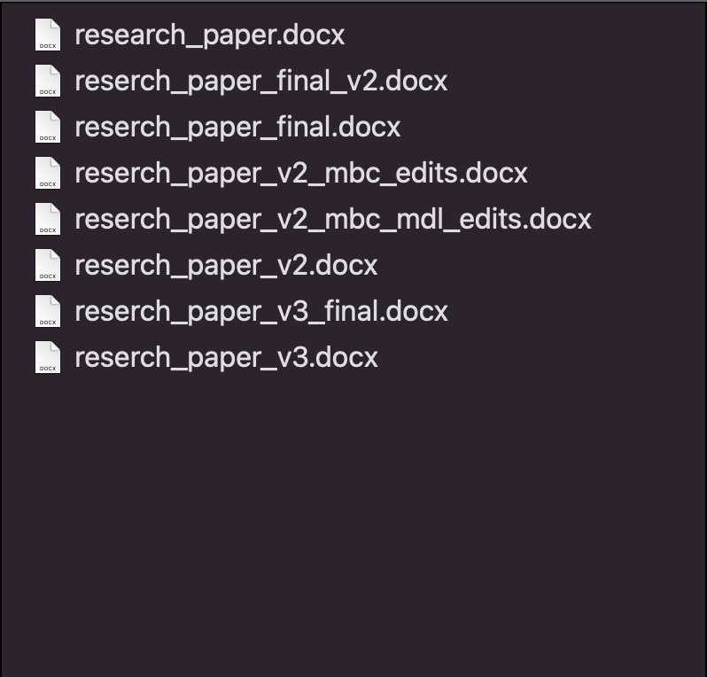

Slide 5
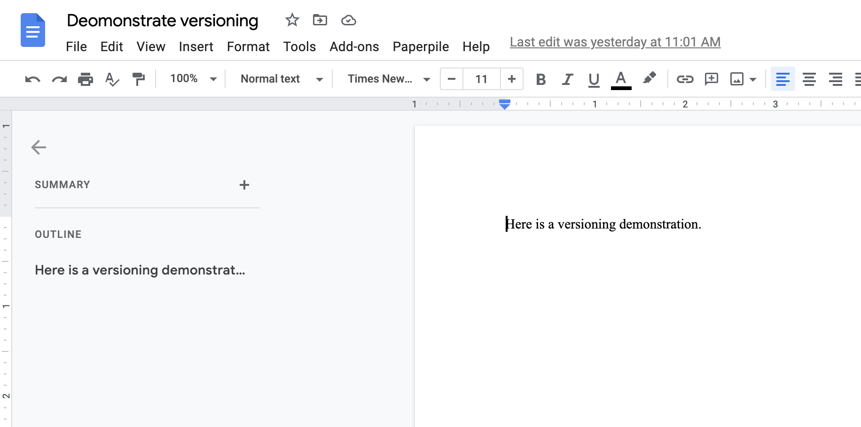

Slide 6
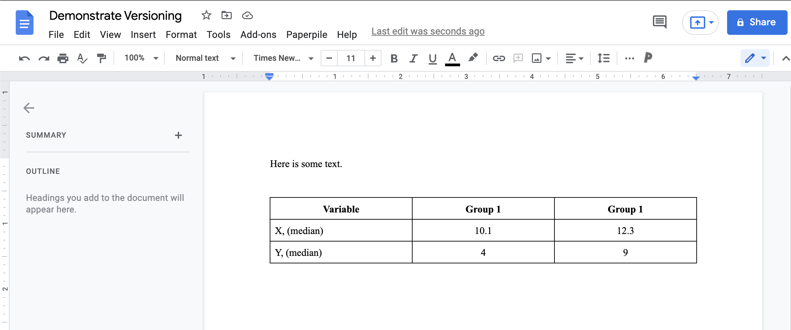

Slide 7
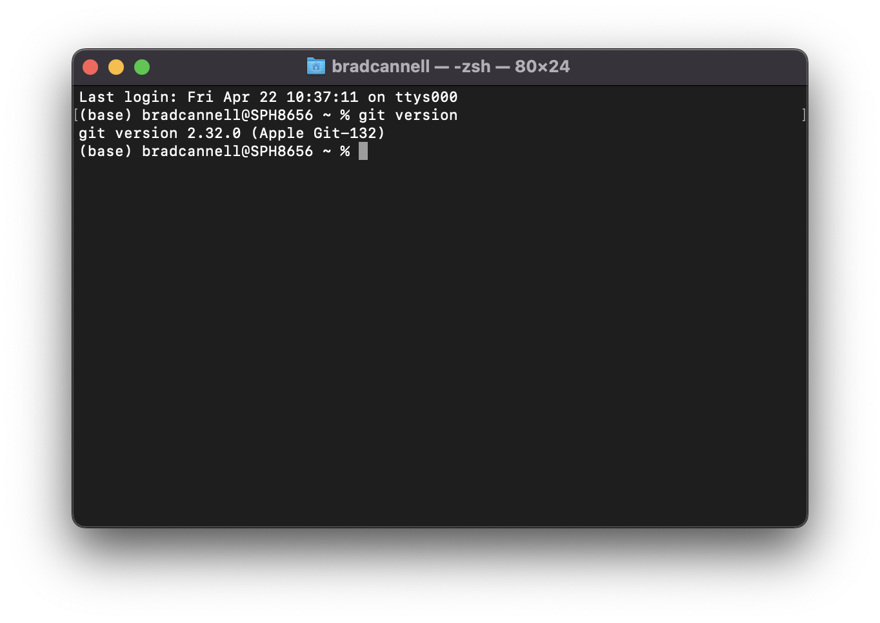

Slide 8


Slide 9


Slide 10


Slide 11
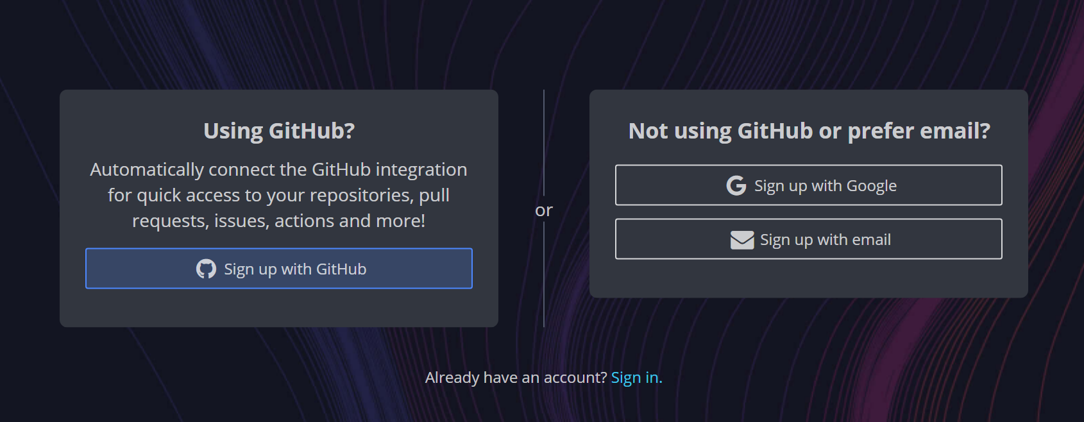

Slide 12
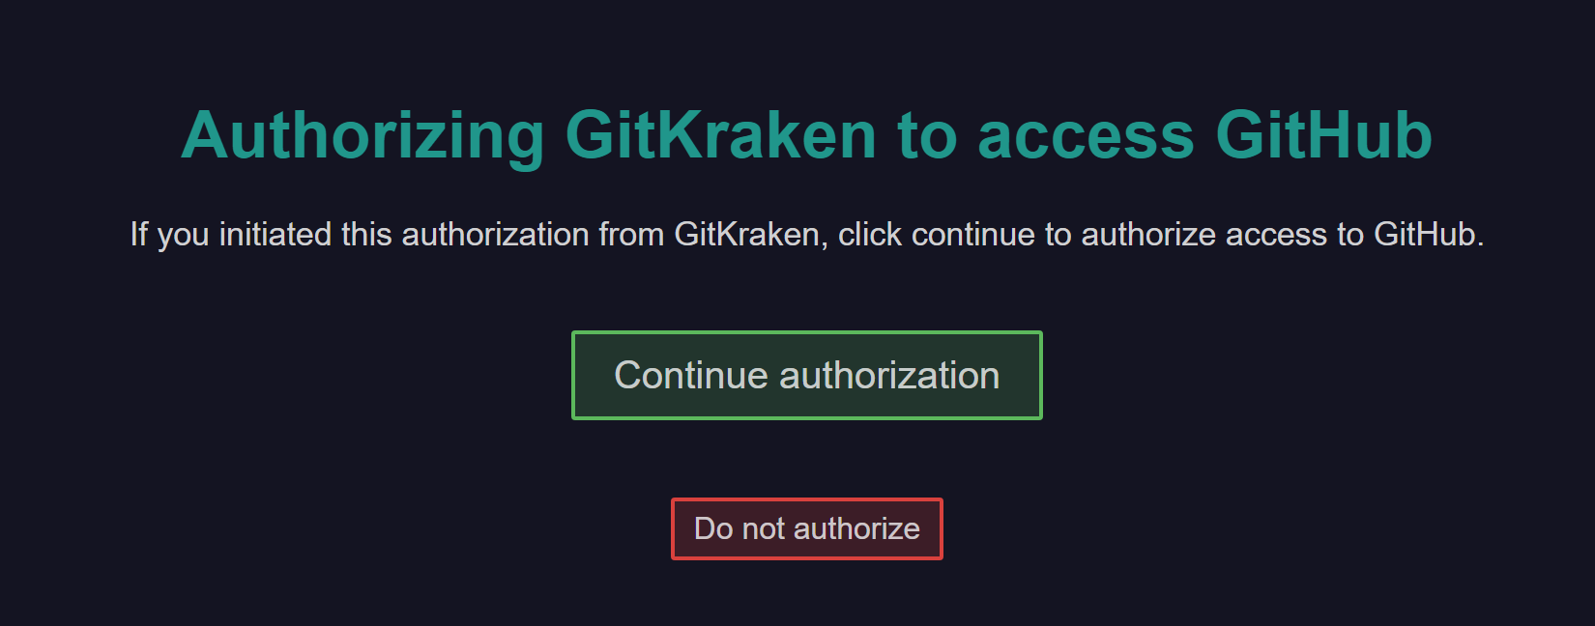

Slide 13


Slide 14
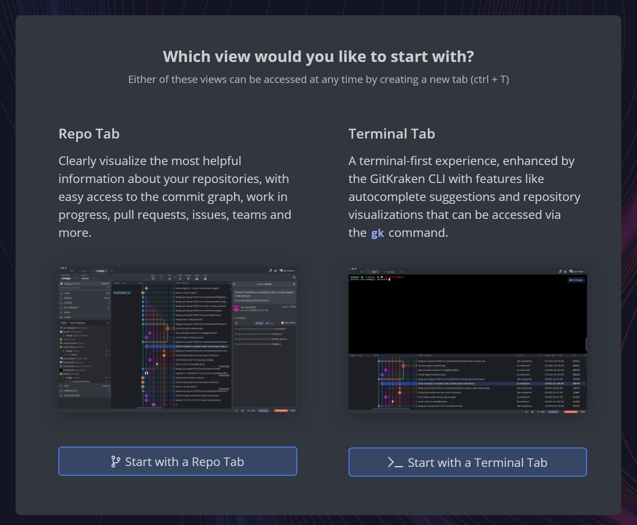

Slide 15




Notes:
What is a repository?

Slide 16
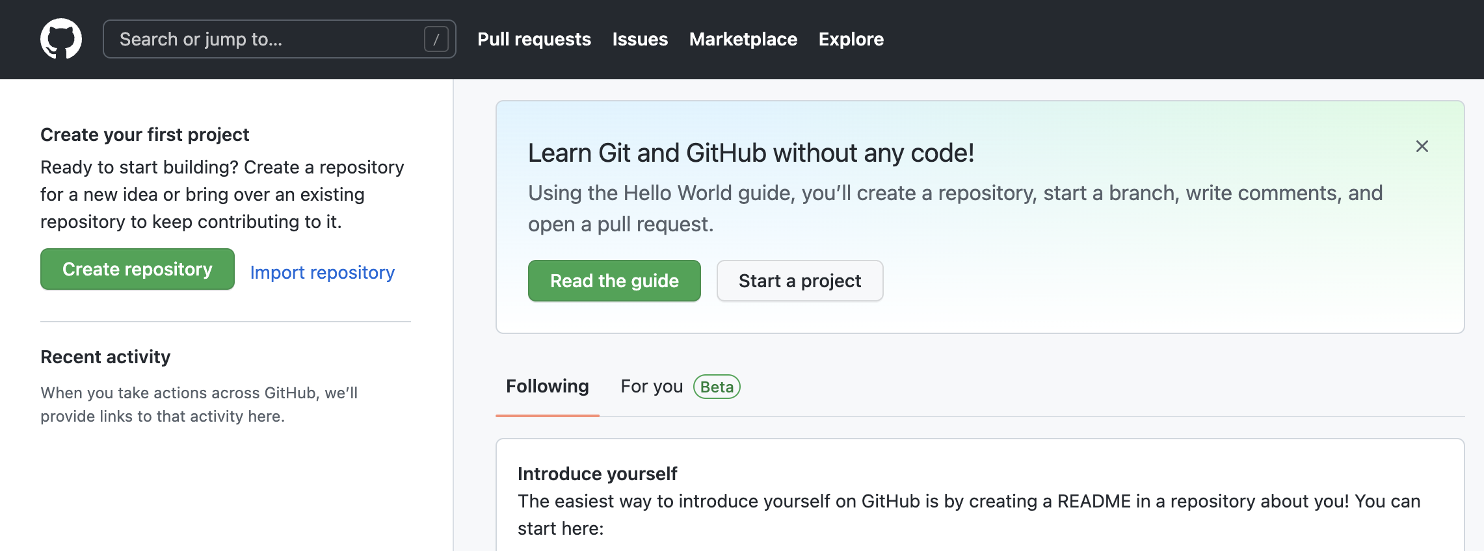
Notes:
new_repository_01_create

Slide 17
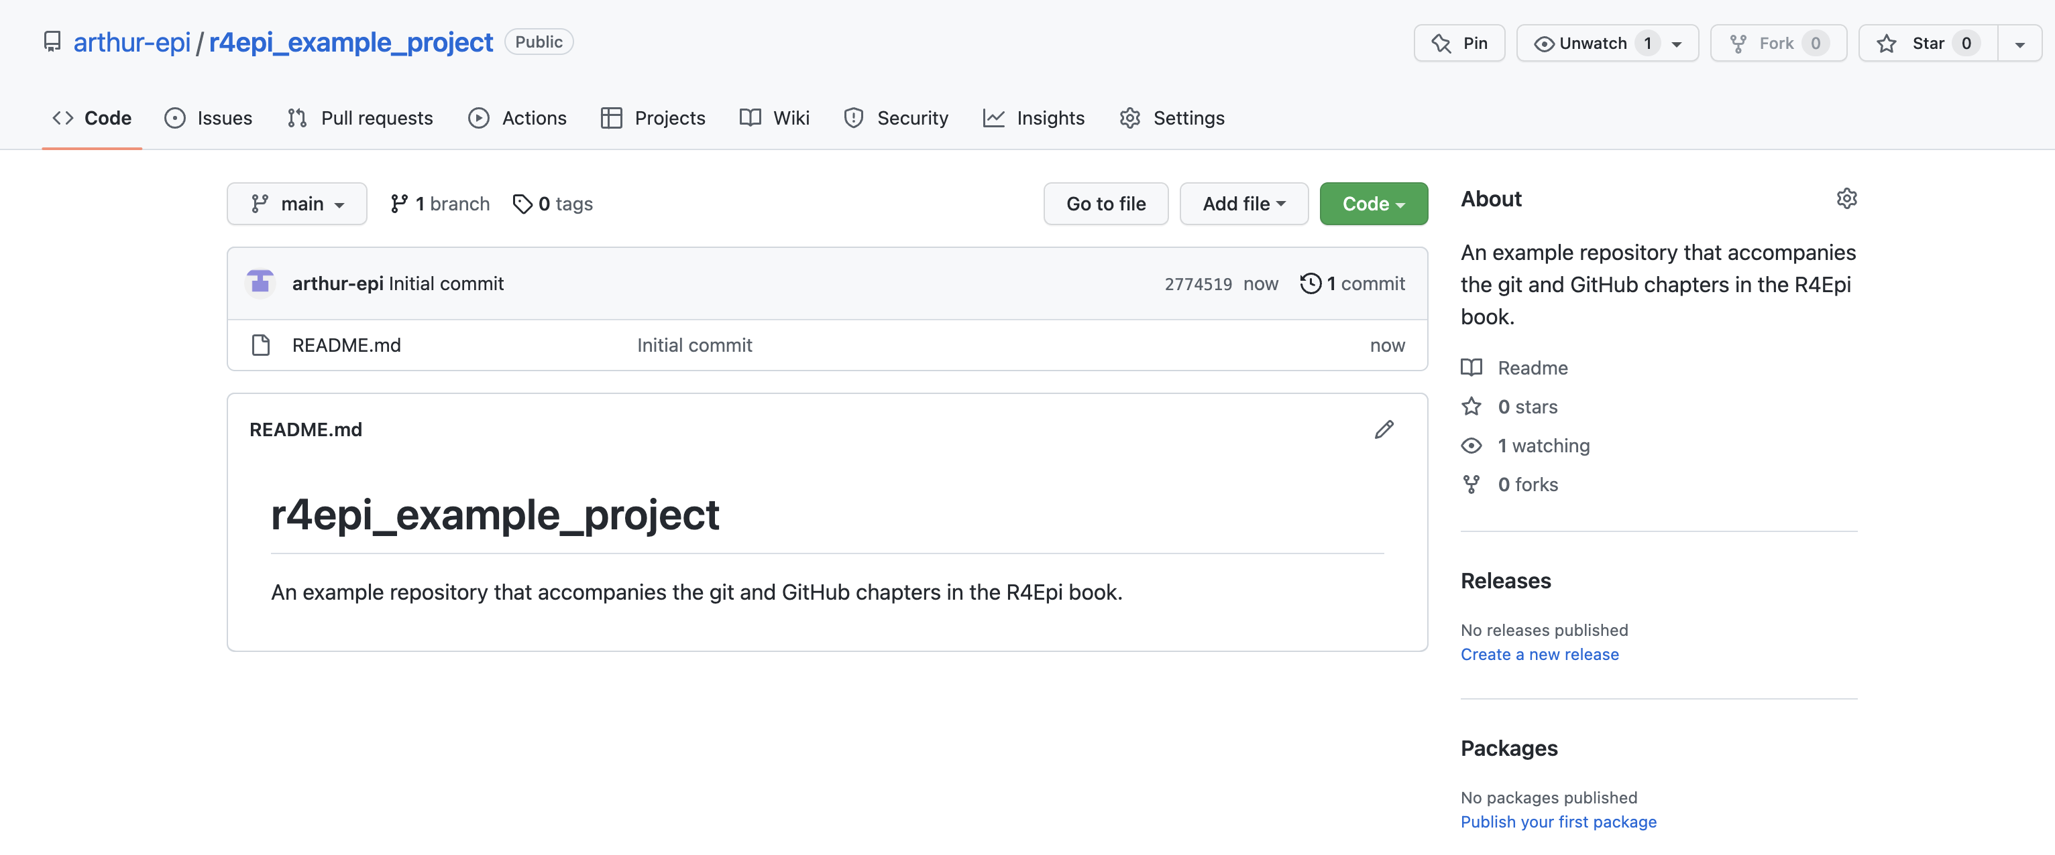
Notes:
new_repository_03_files

Slide 18
Notes:
new_repository_04_about

Slide 19
Notes:
new_repository_05_readme

Slide 20
Notes:
new_repository_06_commit

Slide 21
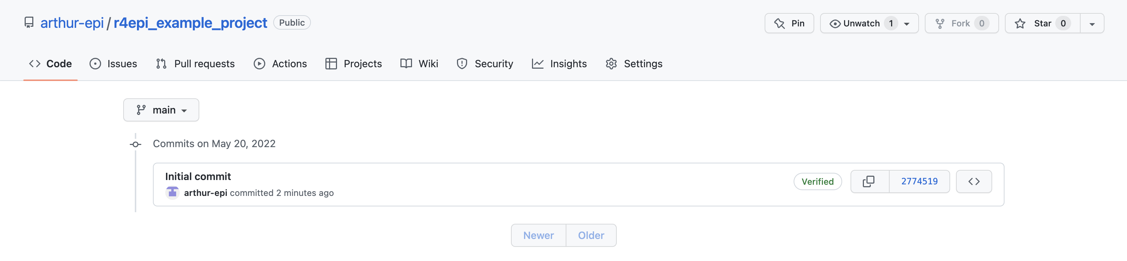
Notes:
new_repository_07_commit_history

Slide 22
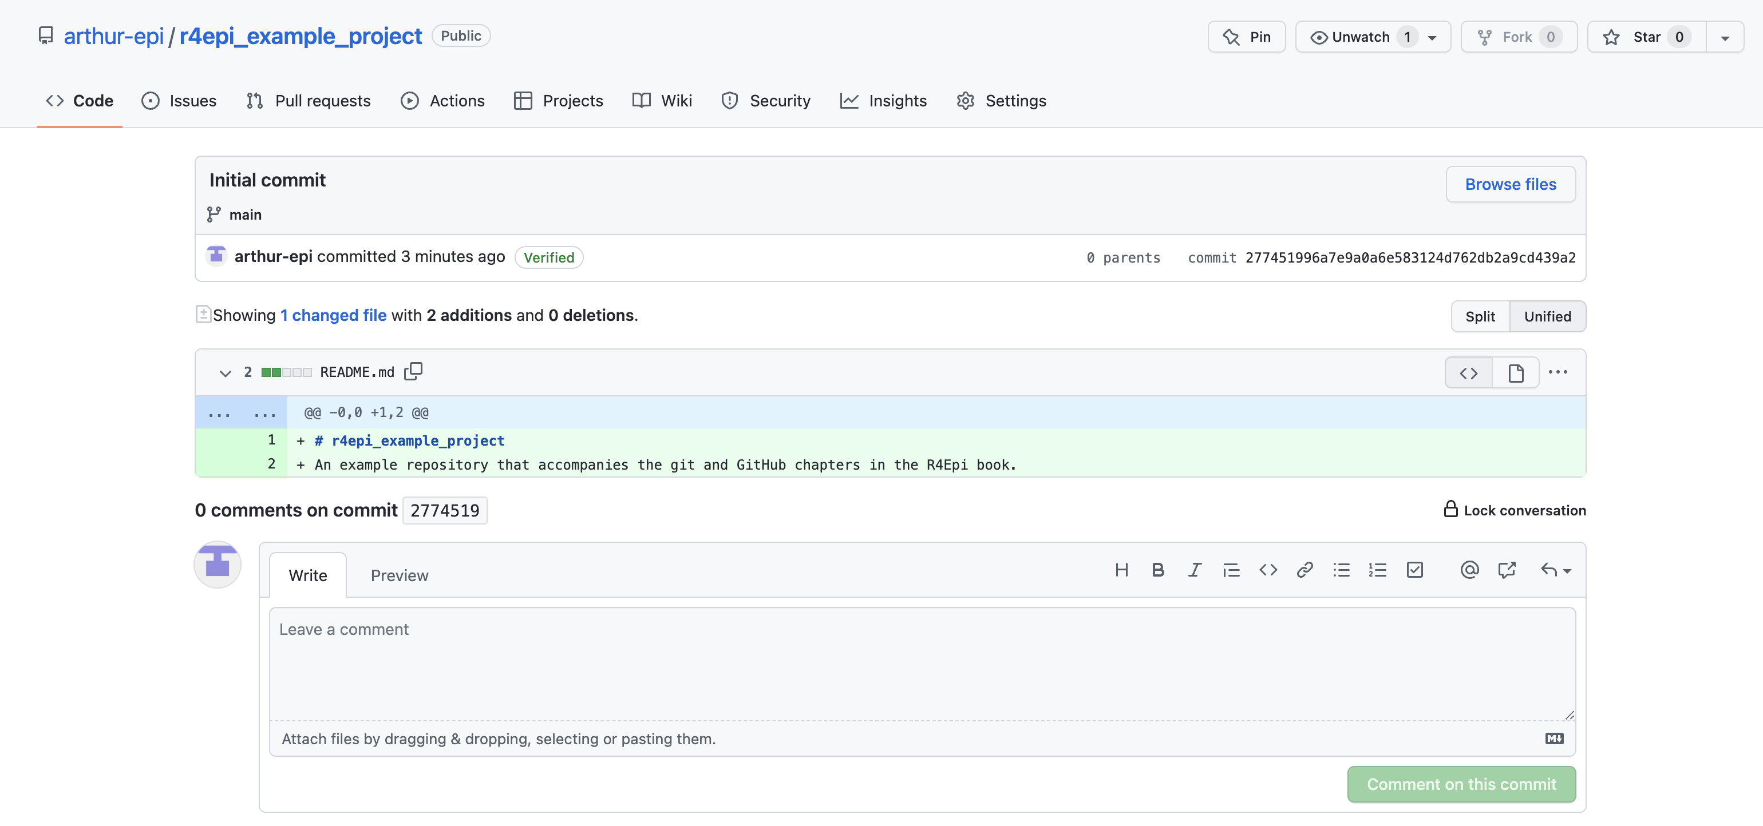
Notes:
new_repository_08_commit_details_01

Slide 23
Notes:
new_repository_08_commit_details_02

Slide 24
Notes:
new_repository_08_commit_details_03

Slide 25
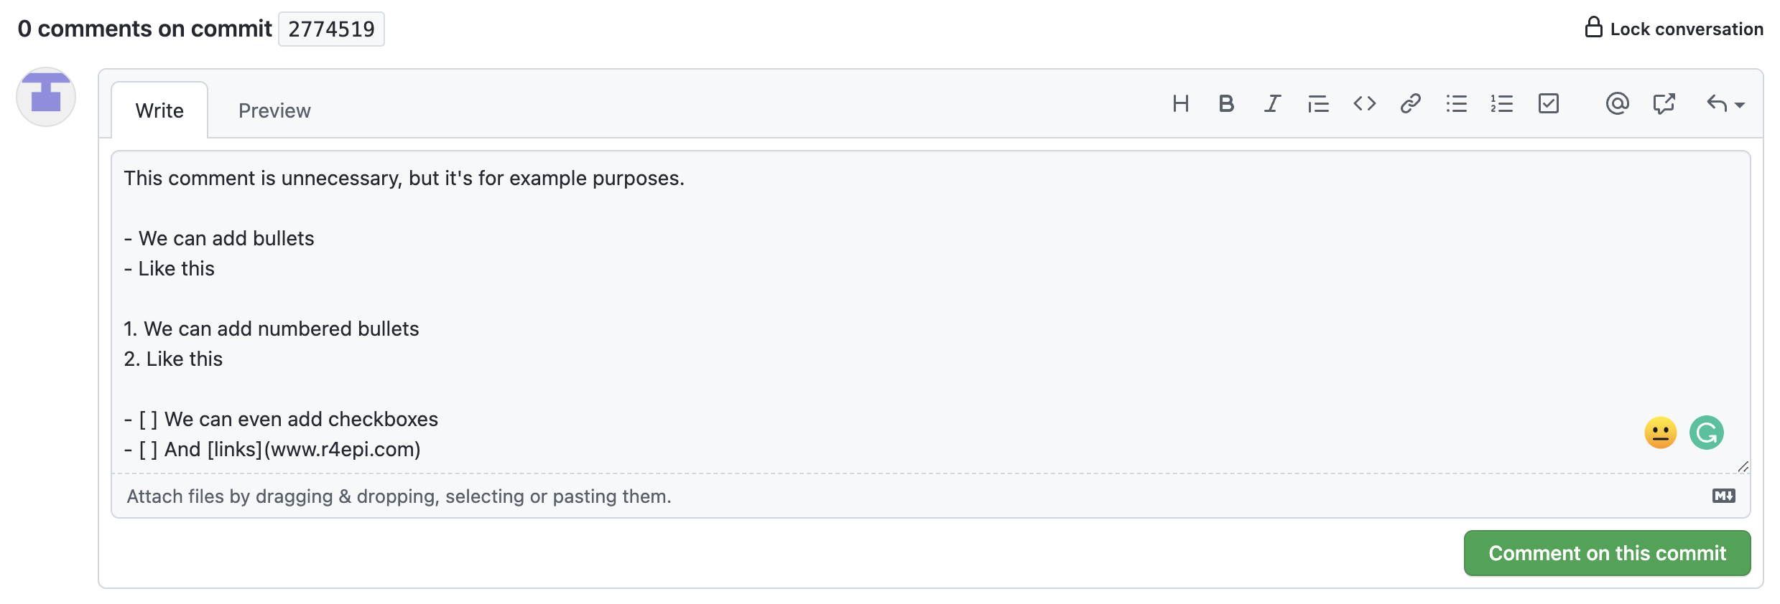
Notes:
new_repository_08_commit_details_04

Slide 26



README.md

Slide 27
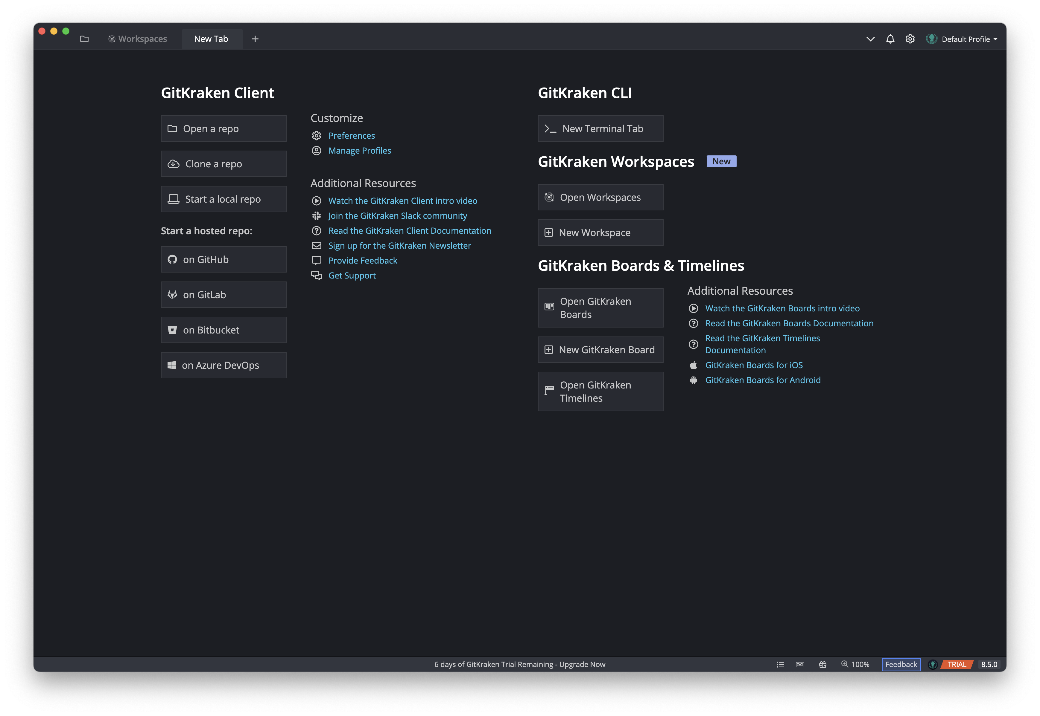
Notes:
new_repository_10_clone_01

Slide 28
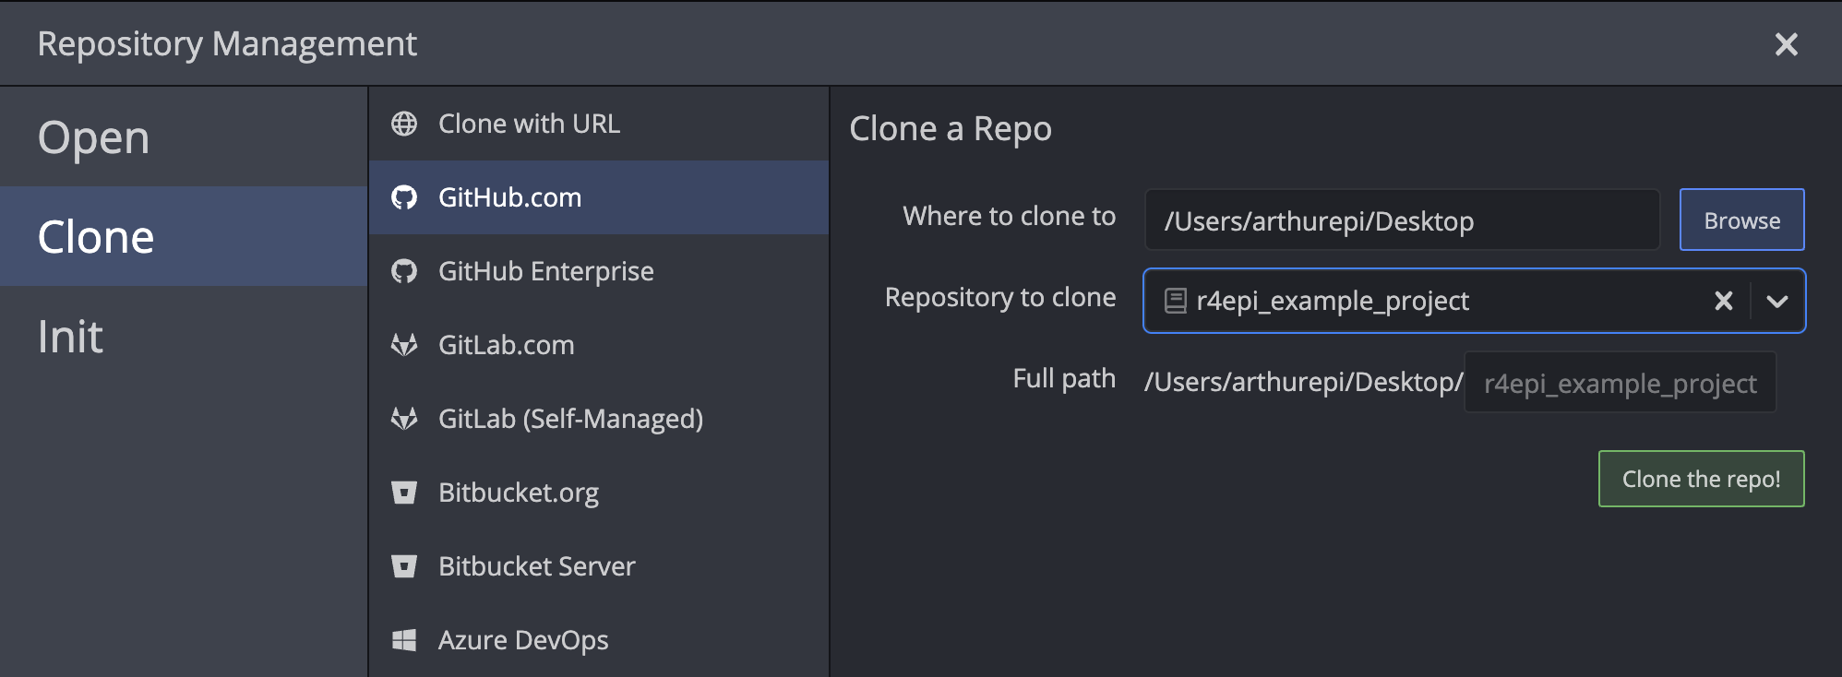
2
1
3

Slide 29

Remote Repository (“repo”)
README.md
Cloned
Local Repository (“repo”)
README.md
Notes:
new_repository_10_clone_03

Slide 30
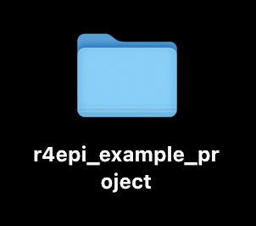
Notes:
new_repository_11_view_folder

Slide 31
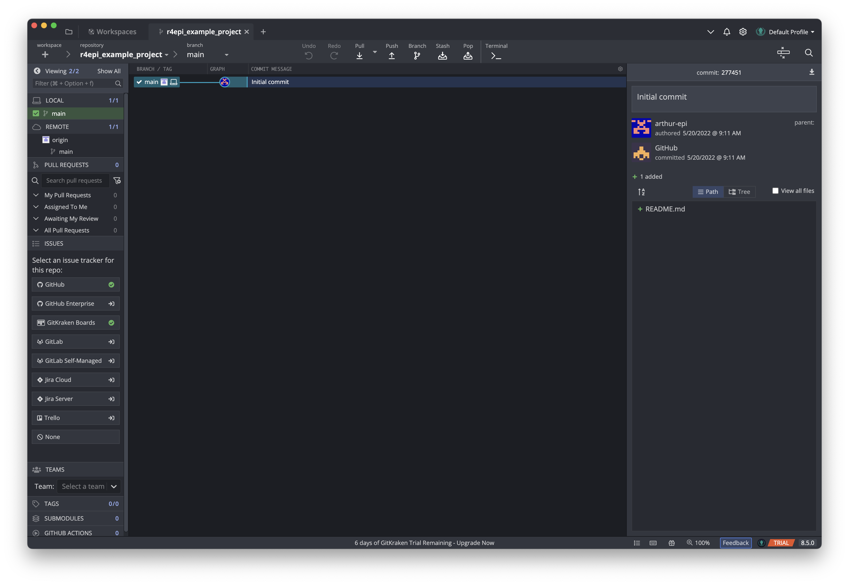
Notes:
new_repository_12_view_gitkraken_01

Slide 32
Notes:
new_repository_12_view_gitkraken_02

Slide 33
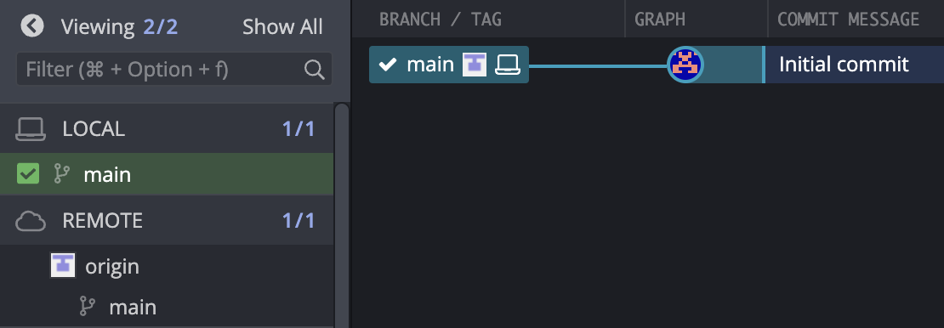
Notes:
new_repository_12_view_gitkraken_03

Slide 34
Notes:
new_repository_12_view_gitkraken_04

Slide 35
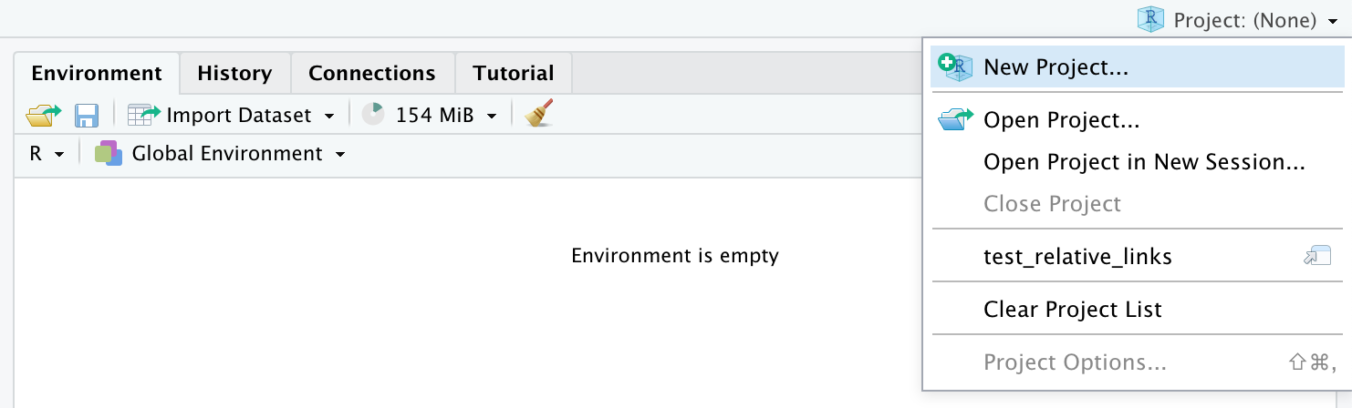
Notes:
new_repository_13_new_project_01

Slide 36
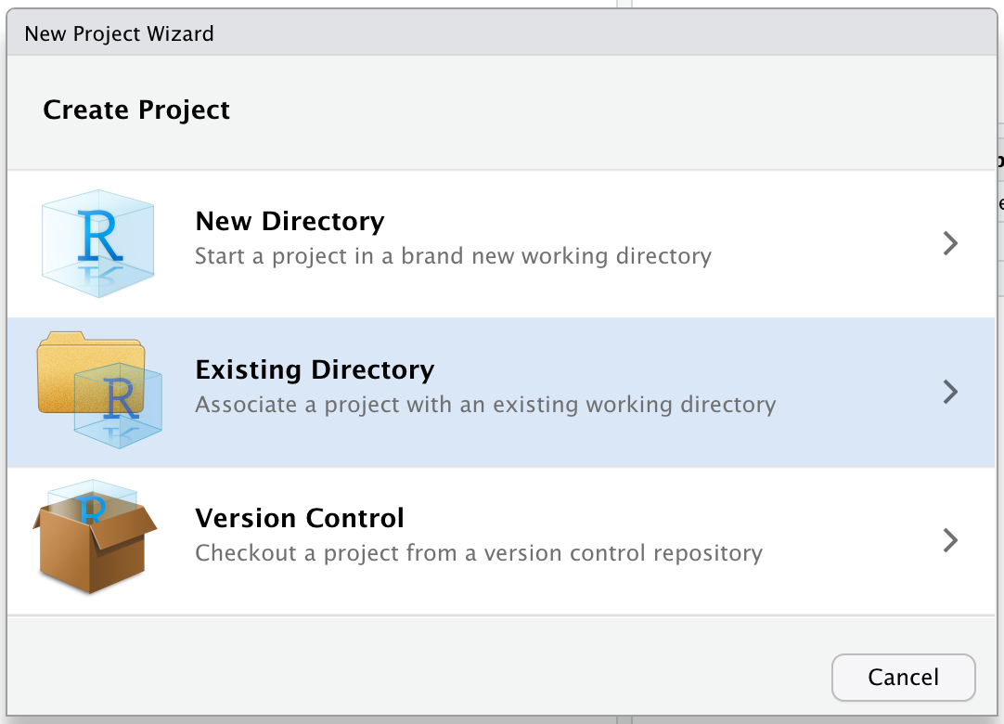
Notes:
new_repository_13_new_project_02

Slide 37
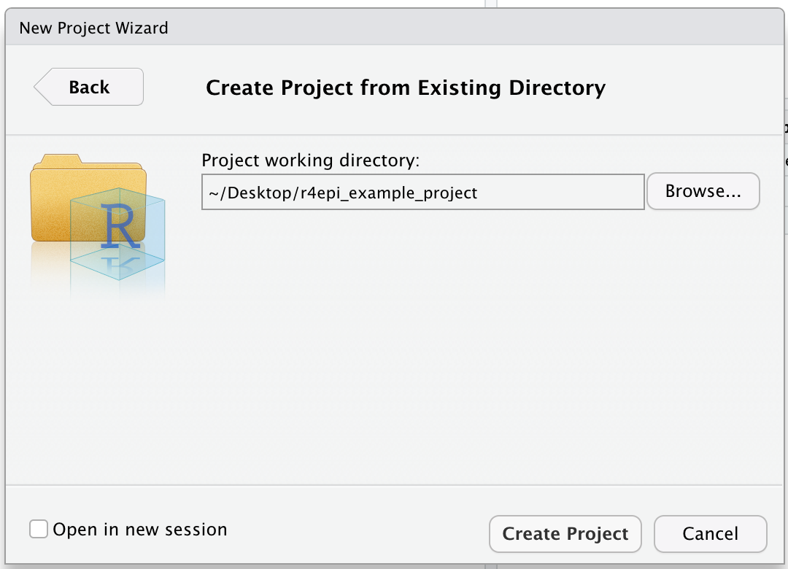
Notes:
new_repository_13_new_project_03

Slide 38
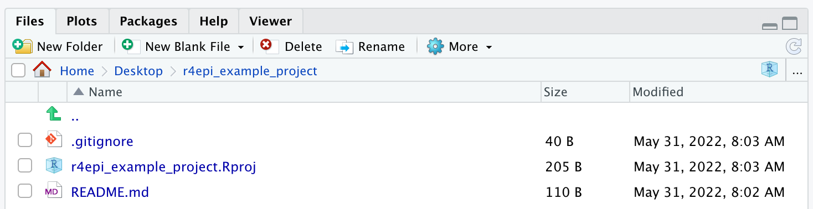
Notes:
new_repository_14_gitignore_01

Slide 39
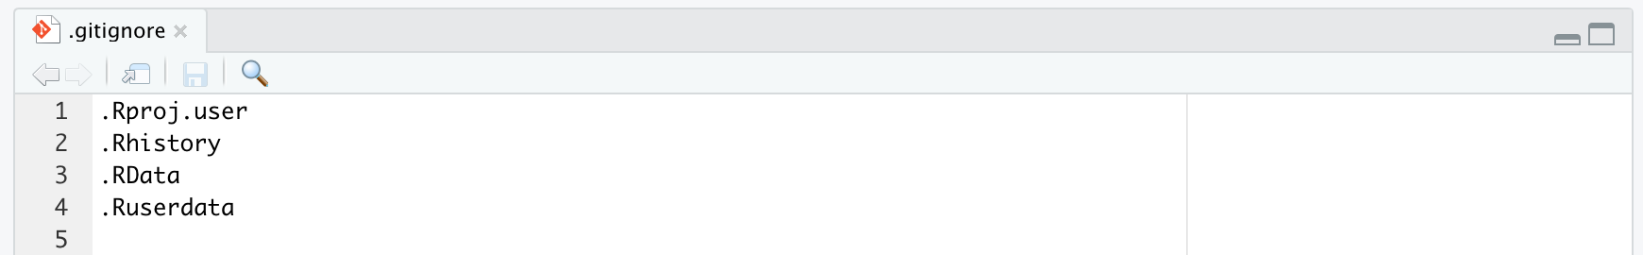
Notes:
new_repository_14_gitignore_02

Slide 40
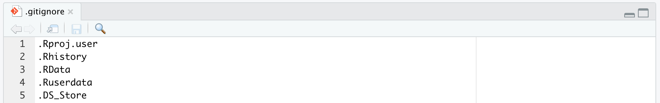
Notes:
new_repository_14_gitignore_03
It stands for Desktop Services Store and it holds meta information about your folder’s thumbnails, settings, etc.
.DS_Store files are created any time you navigate to a file or folder from the Finder on a Mac.

Slide 41
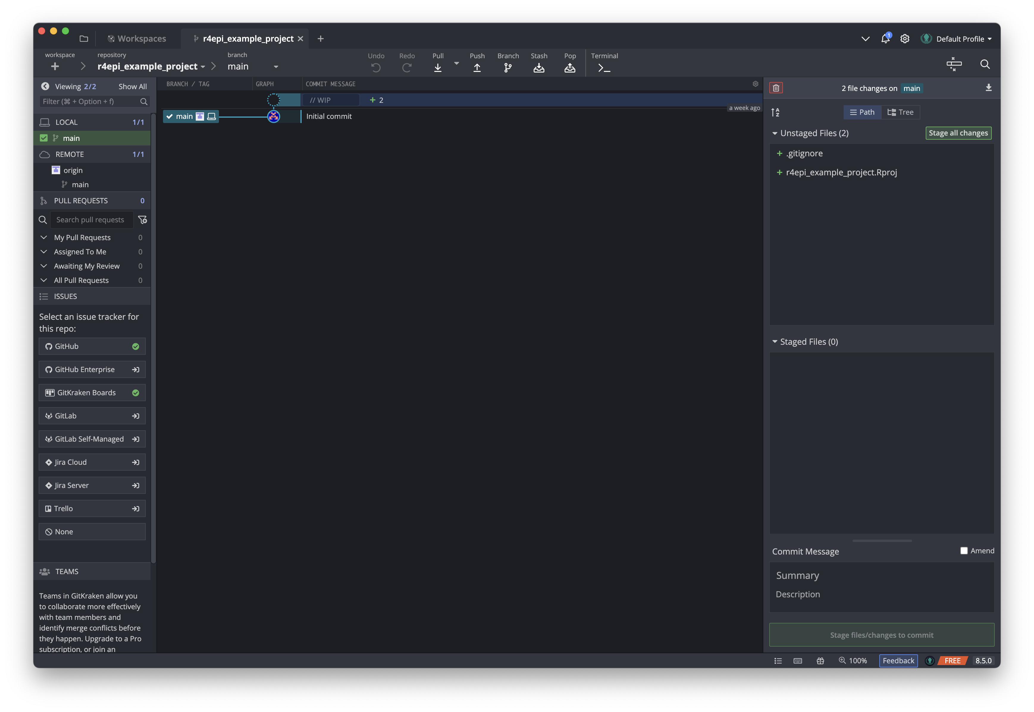
Notes:
new_repository_15_commit_01

Slide 42
Notes:
new_repository_15_commit_02

Slide 43
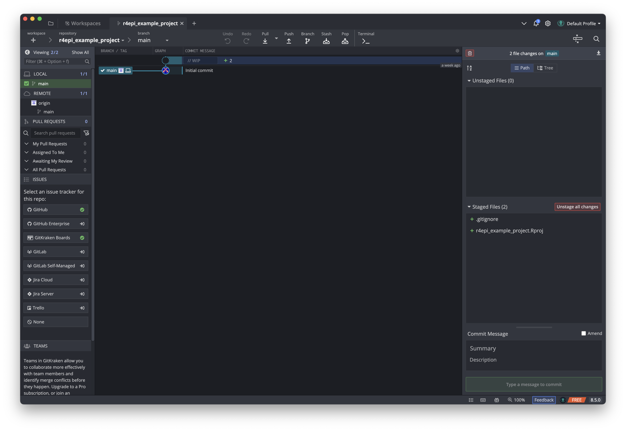
Notes:
new_repository_15_commit_03

Slide 44
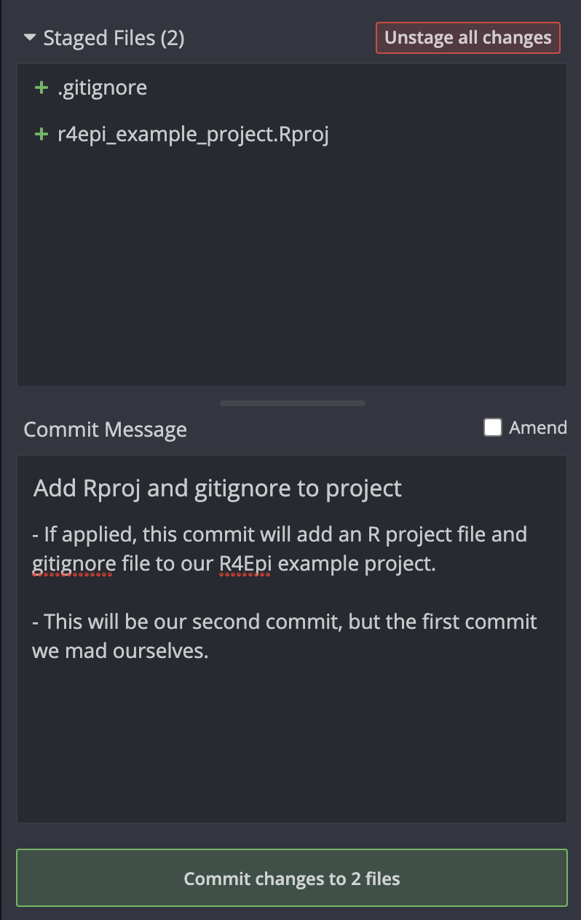
1
2
3
Notes:
new_repository_15_commit_04

Slide 45
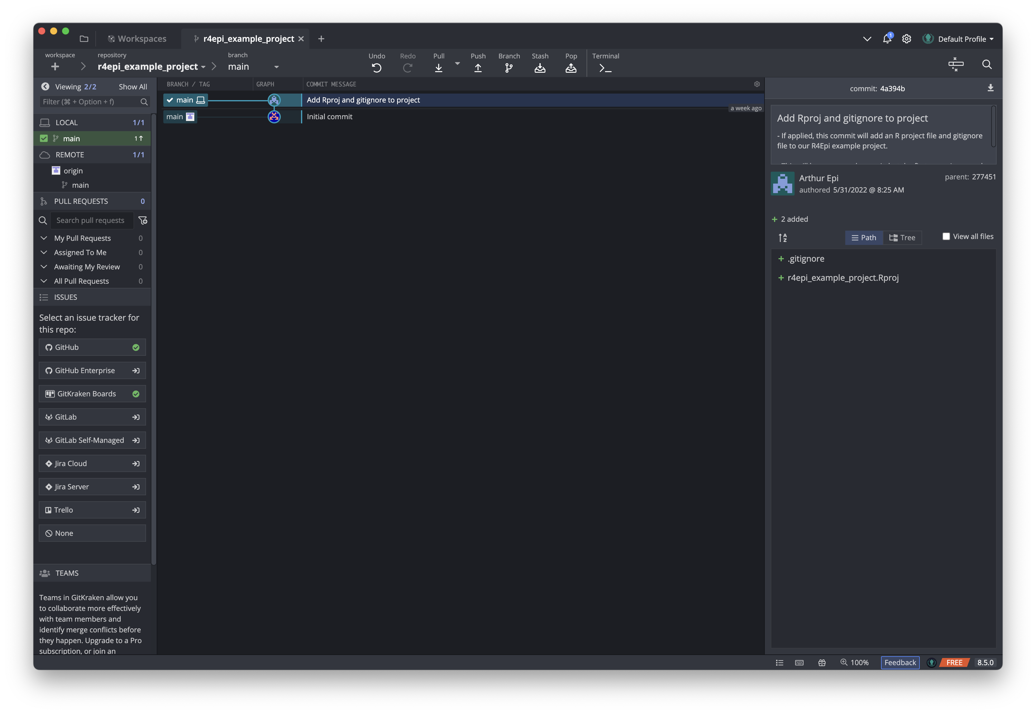
Notes:
new_repository_15_commit_05

Slide 46
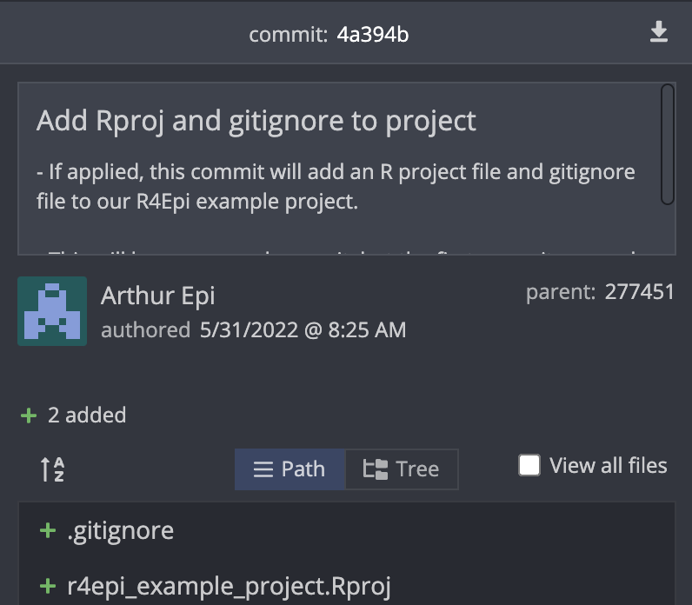
Notes:
new_repository_15_commit_06

Slide 47
Parent
Child
Commit
277451
Commit
4a394b
Past
Present
Notes:
new_repository_15_commit_07

Slide 48
Parent
Child
Commit
277451
Commit
4a394b
Past
Present
Notes:
new_repository_15_commit_08

Slide 49
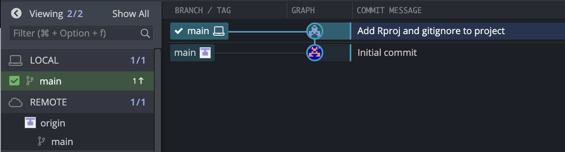
Notes:
new_repository_15_commit_09

Slide 50
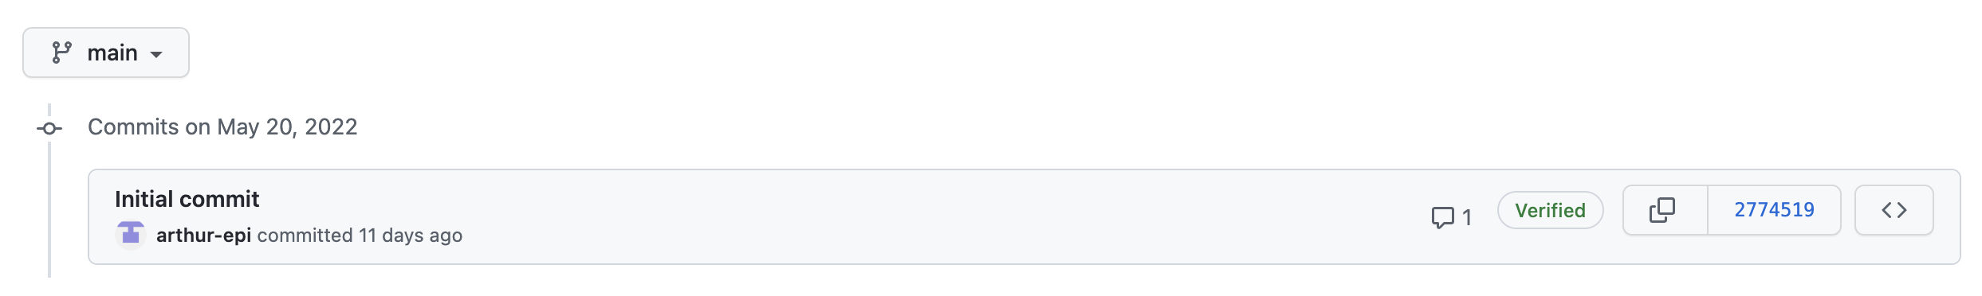
Notes:
new_repository_15_commit_10
We still have only one commit.

Slide 51
Remote Repository (“repo”)
README.md
Cloned
Local Repository (“repo”)
1
README.md
.Rproj
.gitignore
Notes:
new_repository_15_commit_11

Slide 52
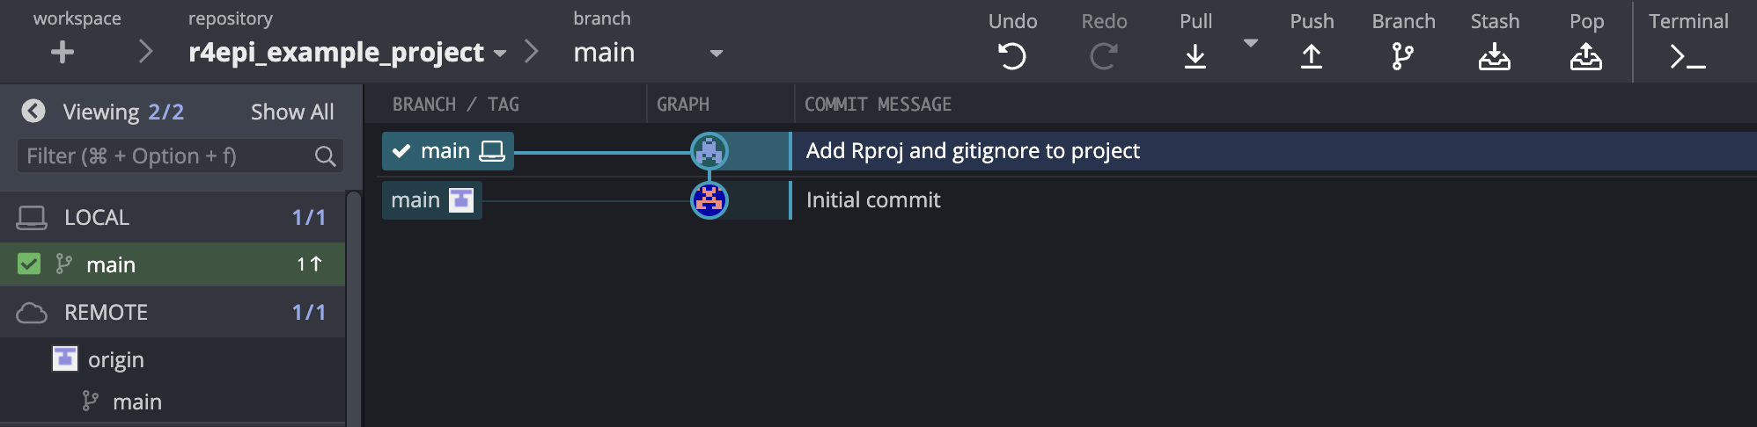
Notes:
new_repository_15_commit_12

Slide 53
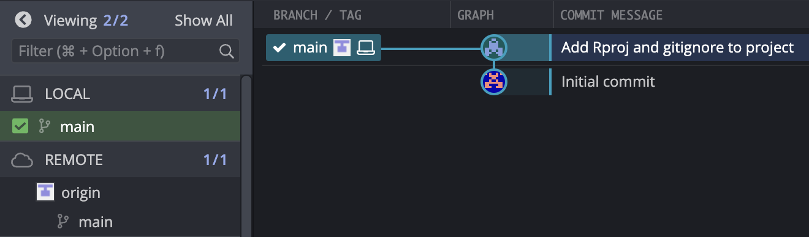
Notes:
new_repository_15_commit_13

Slide 54
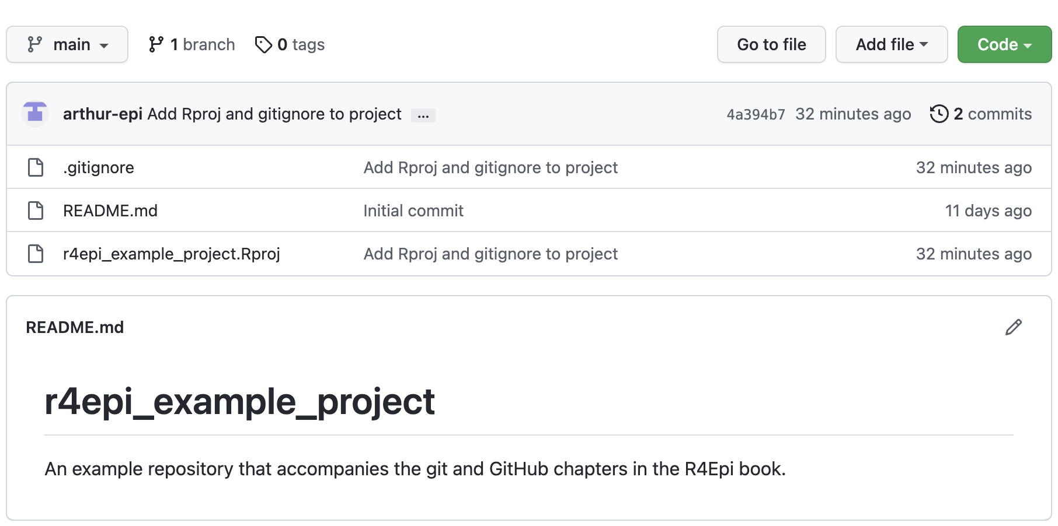
Notes:
new_repository_15_commit_14

Slide 55
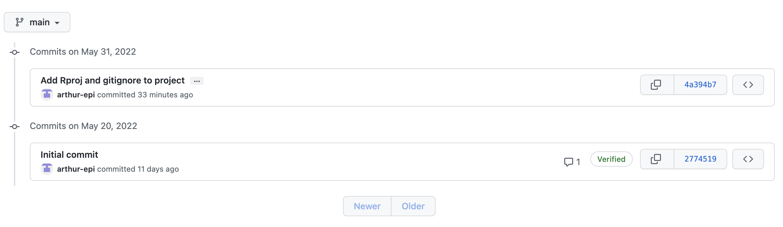
Notes:
new_repository_15_commit_15

Slide 56
Remote Repository (“repo”)
README.md
.Rproj
.gitignore
Push
Local Repository (“repo”)
README.md
.Rproj
.gitignore
Notes:
new_repository_15_commit_16

Slide 57
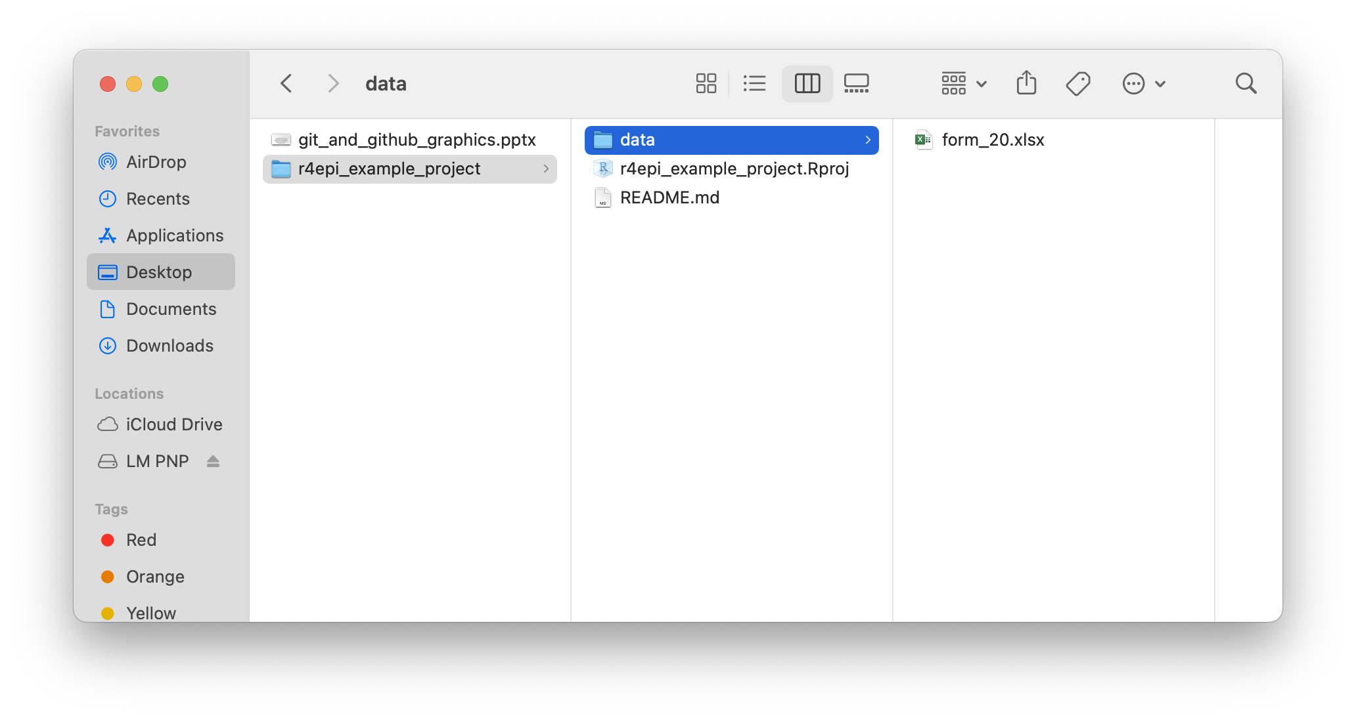
Notes:
new_repository_15_commit_17

Slide 58
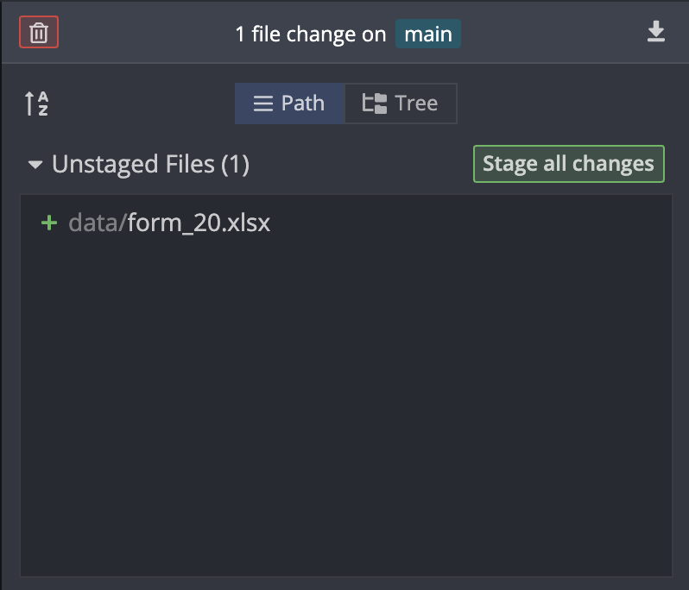
Notes:
new_repository_15_commit_18

Slide 59
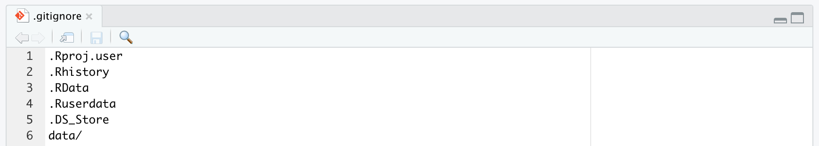
Notes:
new_repository_15_commit_19

Slide 60
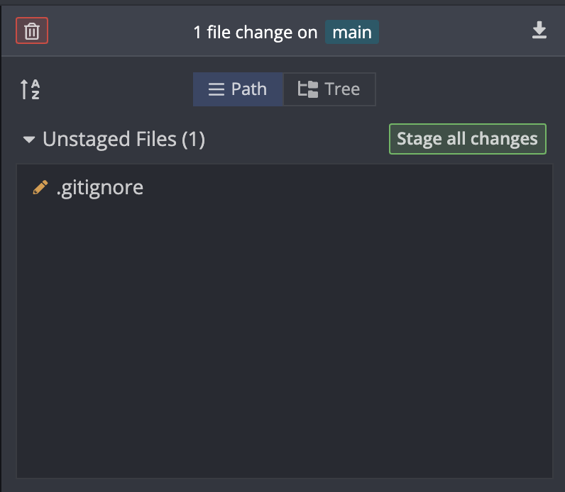
Notes:
new_repository_15_commit_20

Slide 61
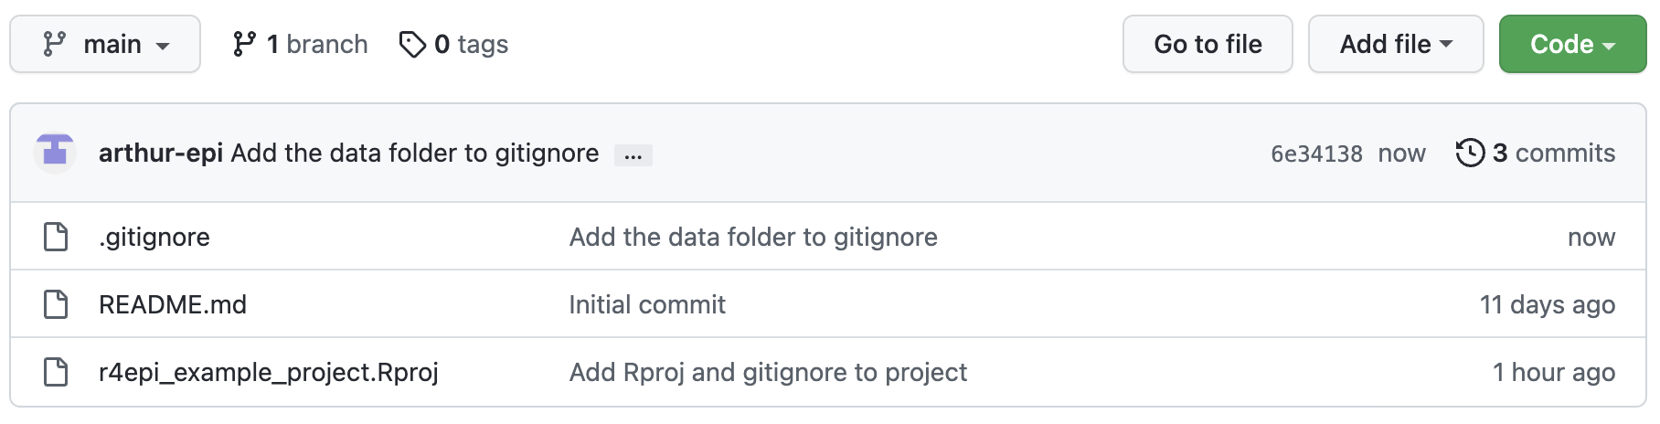
Notes:
new_repository_15_commit_21

Slide 62
Arthur’s
Remote Repository
Clone
Push
Arthur’s
Local Repository
Brad’s
Local Repository
Notes:
forking_01

Slide 63
Arthur’s
Remote Repository
Brad’s
Remote Repository
Fork
Clone
Push
Arthur’s
Local Repository
Notes:
forking_02

Slide 64

Notes:
forking_03

Slide 65
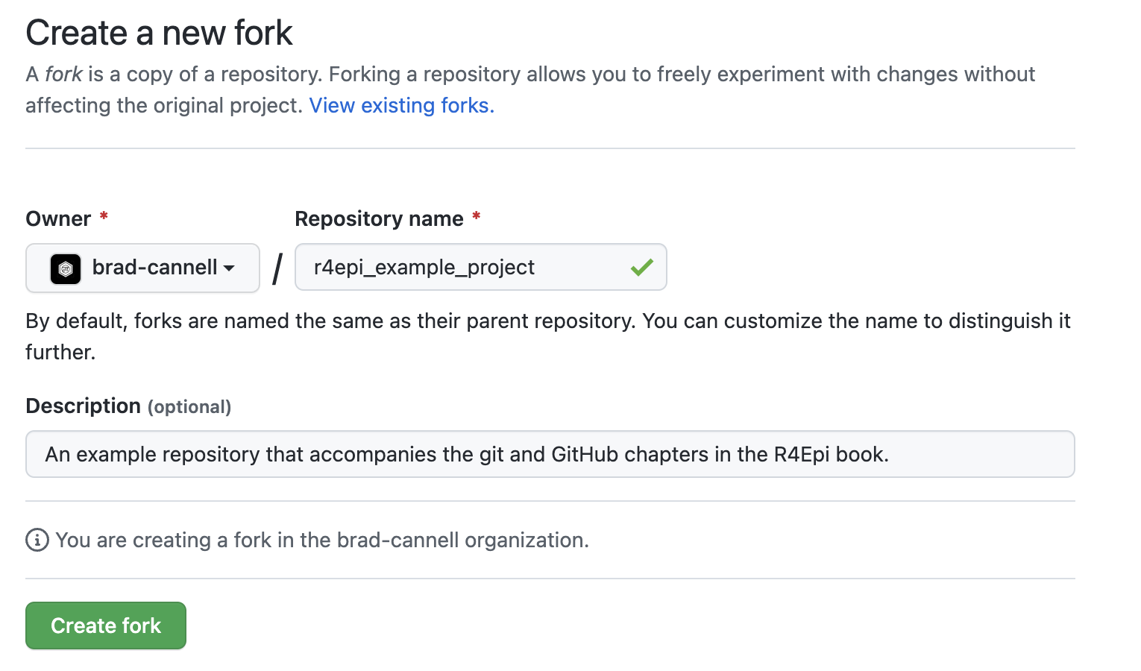
Notes:
forking_04

Slide 66
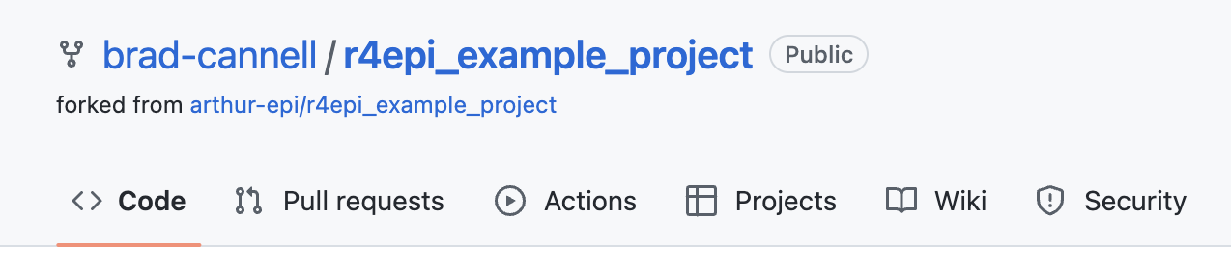
Notes:
forking_05

Slide 67
Arthur’s
Remote Repository
Brad’s
Remote Repository
Fork
Clone
Clone
Push
Push
Arthur’s
Local Repository
Brad’s
Local Repository
Notes:
forking_06

Slide 68
Arthur’s
Remote Repository
Brad’s
Remote Repository
Fork
Pull Request
Clone
Clone
Push
Push
Arthur’s
Local Repository
Brad’s
Local Repository
Notes:
pull_request_01

Slide 69
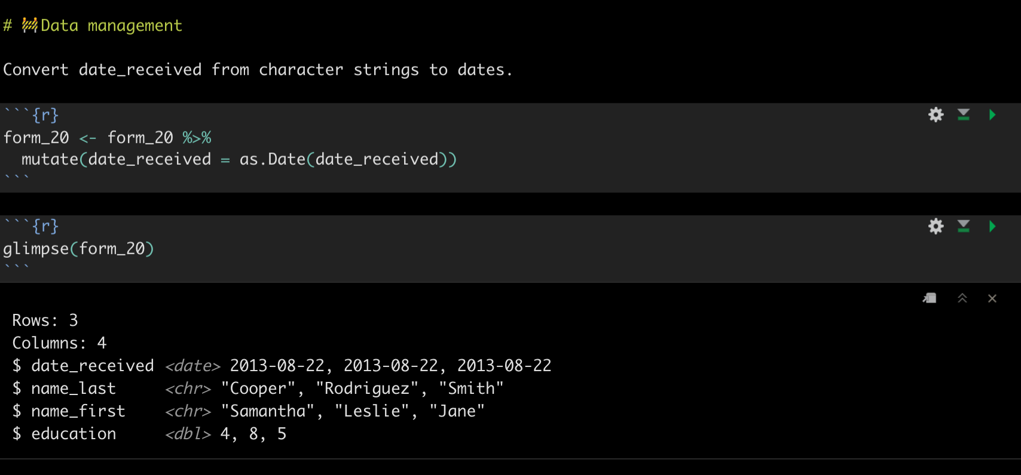
Notes:
pull_request_02

Slide 70
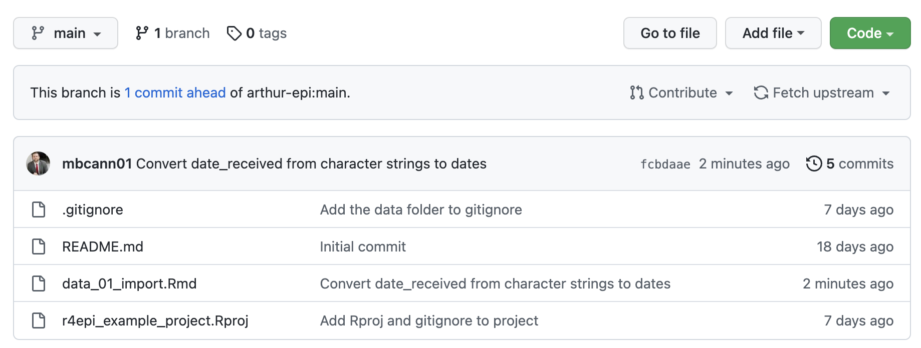
Notes:
pull_request_03

Slide 71
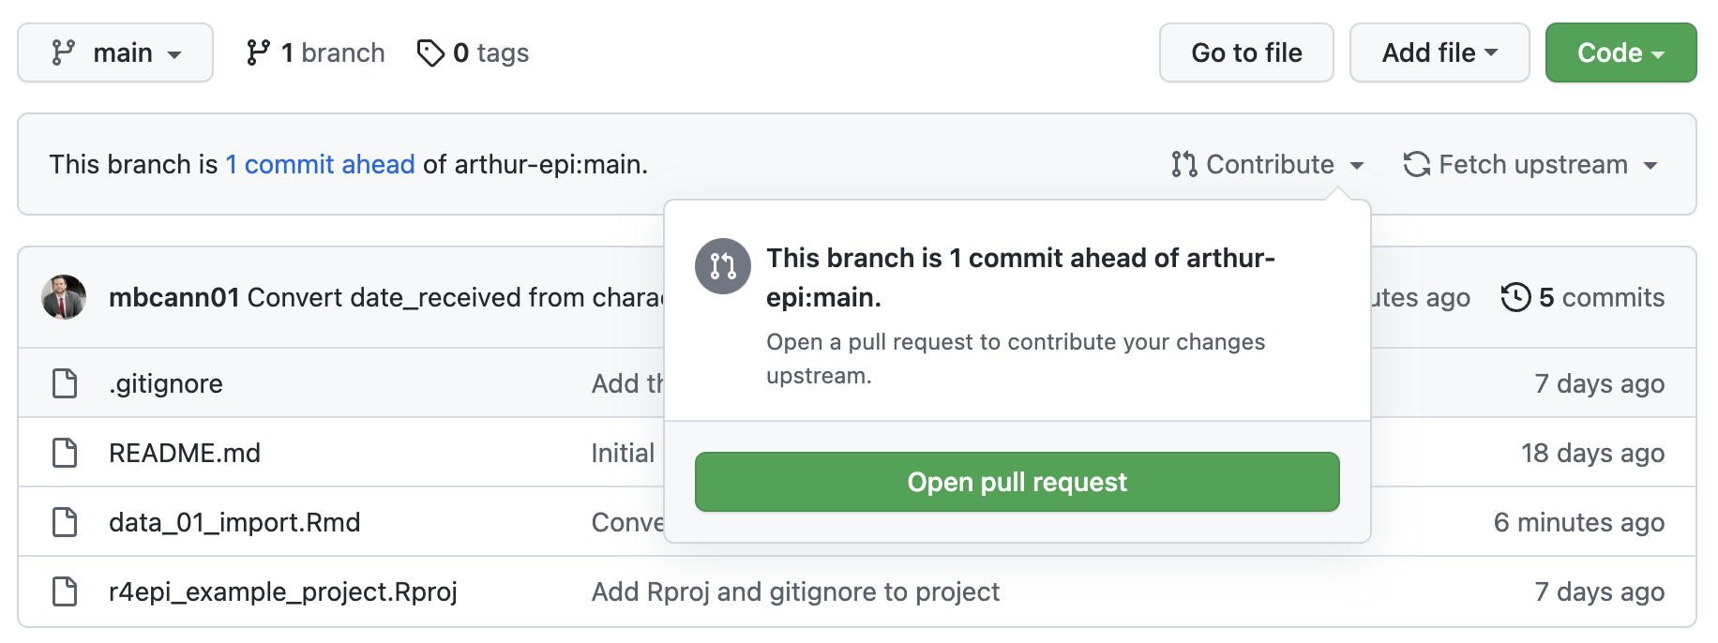
Notes:
pull_request_04

Slide 72
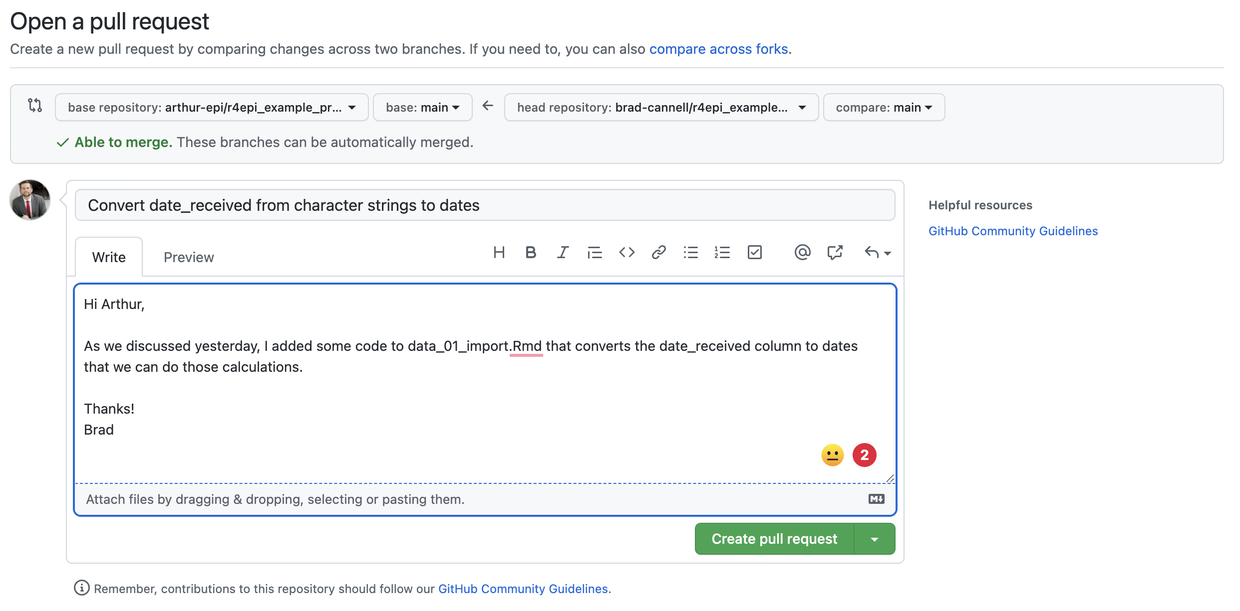
Notes:
pull_request_06

Slide 73
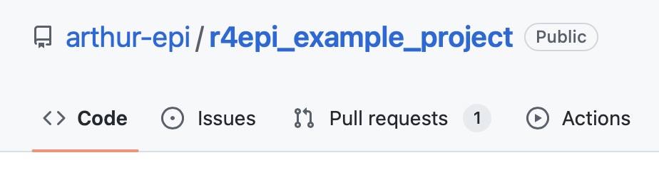
Notes:
pull_request_07

Slide 74
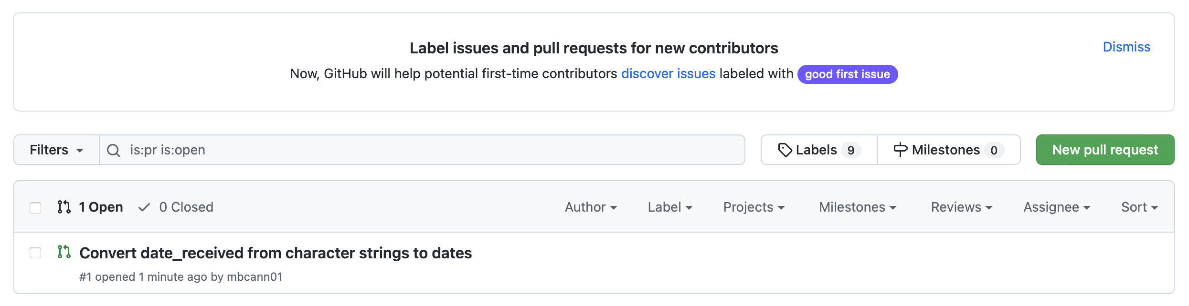
Notes:
pull_request_08

Slide 75
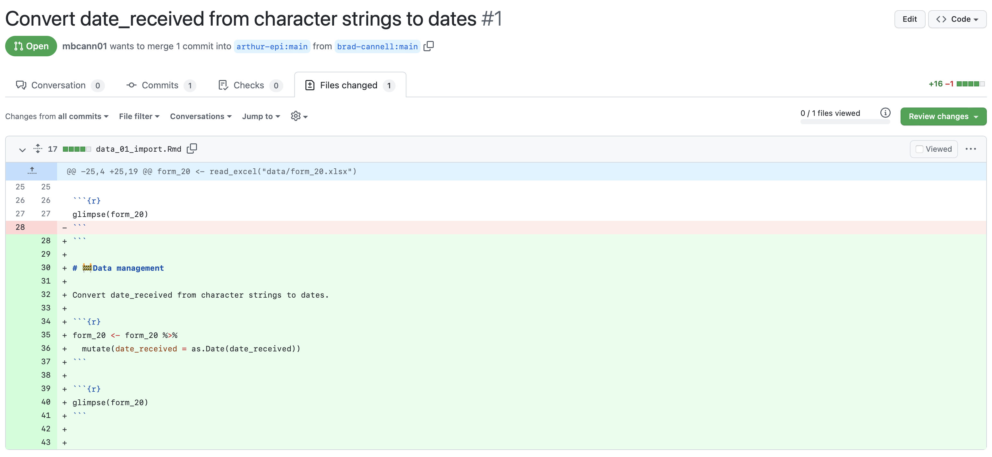
Notes:
pull_request_10

Slide 76
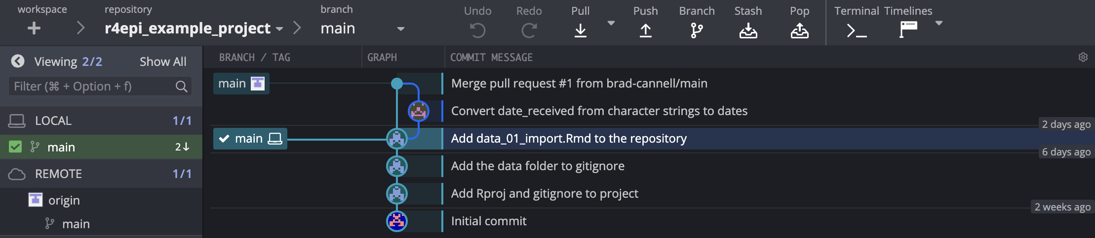
Notes:
pull_request_17

Slide 77
Arthur’s
Remote Repository
Brad’s
Remote Repository
4
3
Pull Request
?
2
Push
1
Arthur’s
Local Repository
Brad’s
Local Repository
Notes:
pull_request_18

Slide 78
Arthur’s
Remote Repository
Brad’s
Remote Repository
4
3
Pull Request
2
Pull
5
Push
1
Arthur’s
Local Repository
Brad’s
Local Repository
Notes:
pull_request_19

Slide 79
Notes:
pull_request_20

Slide 80
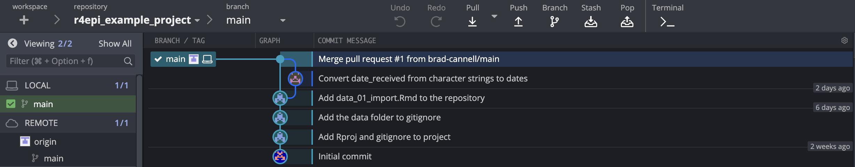
Notes:
pull_request_21

Slide 81

Notes:
pull_request_23

Slide 82
Arthur’s
Remote Repository
Brad’s
Remote Repository
Fetch
Pull Request
Pull
Arthur’s
Local Repository
Brad’s
Local Repository
Notes:
pull_request_24

Slide 83

Notes:
pull_request_25

Slide 84

Notes:
pull_request_26

Slide 85
References
R4Epi
R Notes
Git book
Happy Git for the useR
Jenny’s Git paper on Paperpile

